Slide 1
IPL Analysis
Project - May Batch
A guide by Sudhanshu Bhawsar

Slide 2

Agenda
Introduction
Database Schema
Insights
Suggestions
Conclusion

Slide 3

Introduction
The main objective of this project is that team RCB looking for top-performing and reliable players to win tournaments, considering both on-field performance and value for money in mega player auction of 2017.

Slide 4
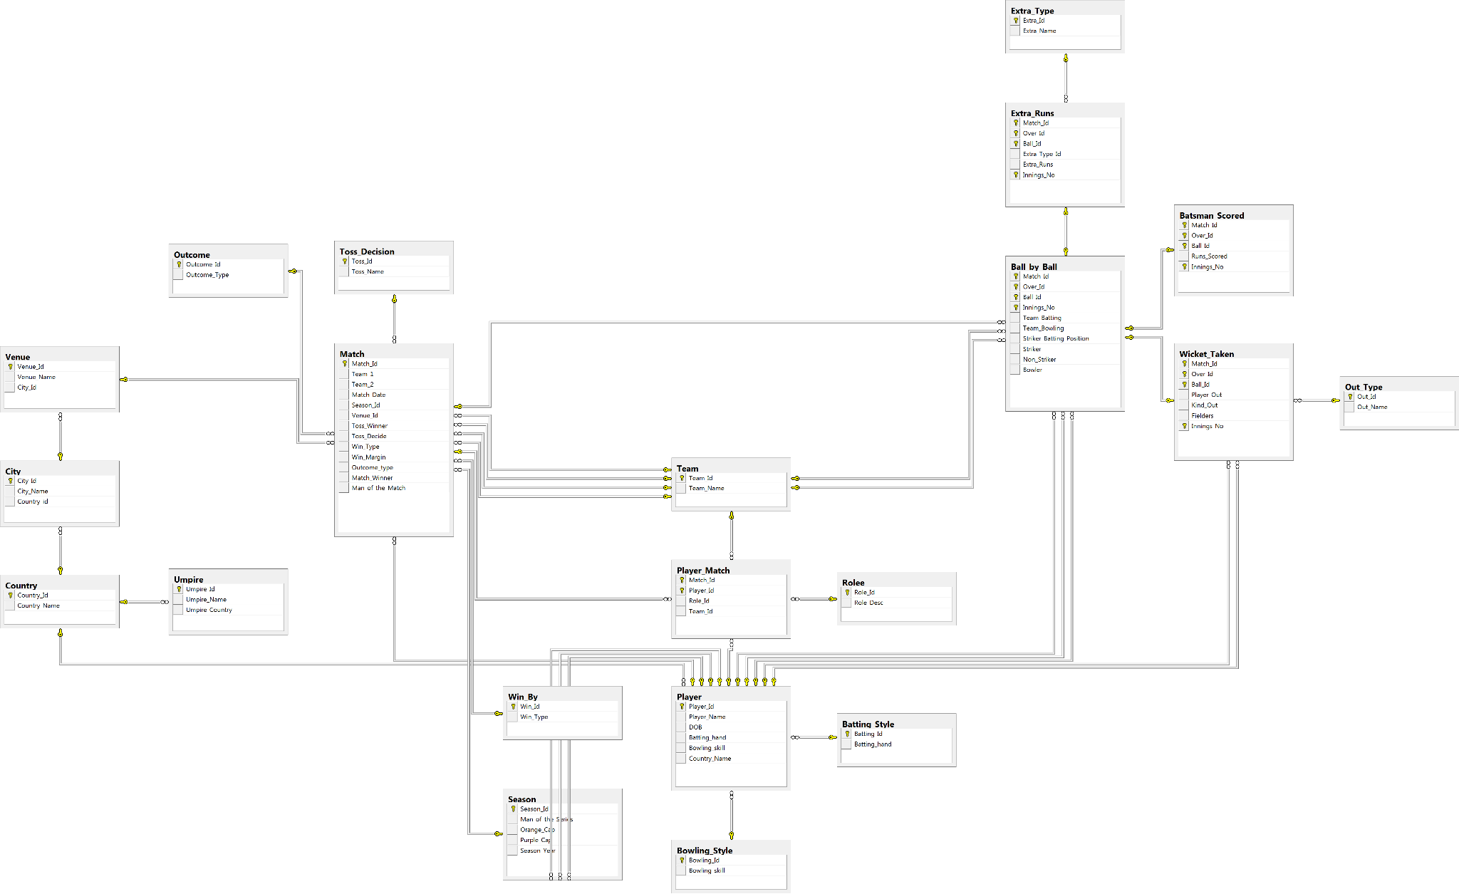
Database Schema

Slide 5
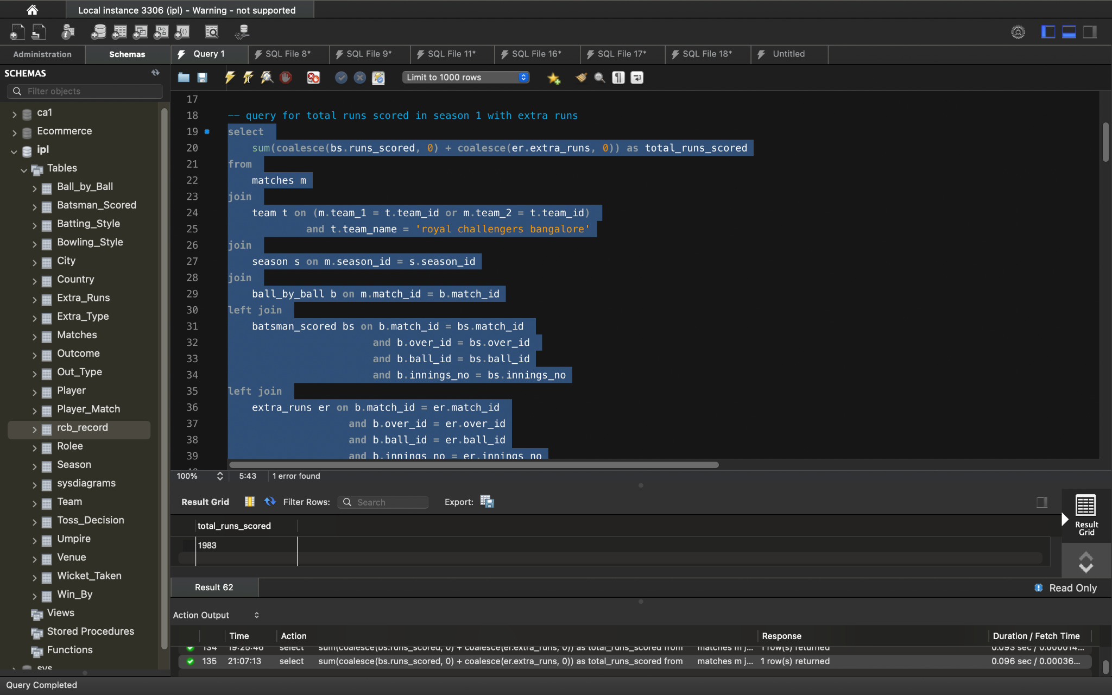

Total number of runs scored by RCB in season 1

Slide 6
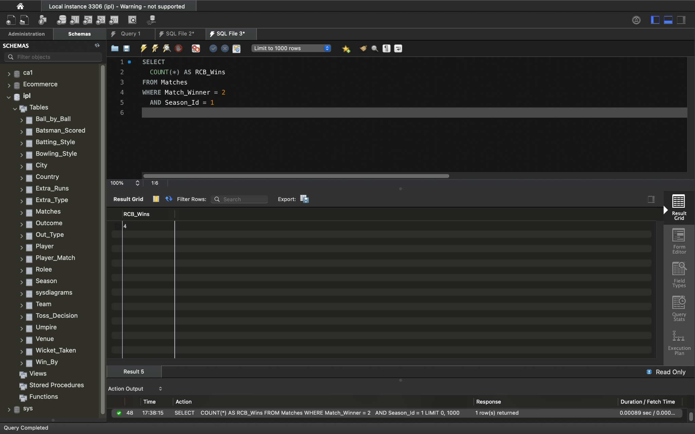
Matches won by RCB in season 1

Slide 7
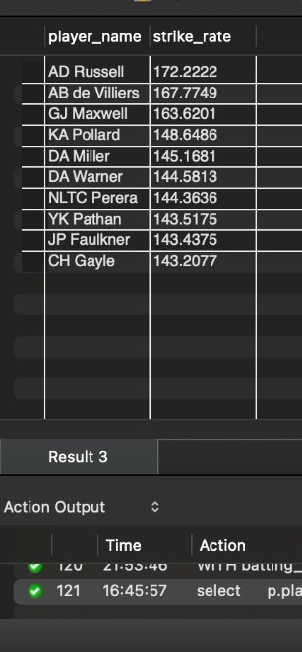
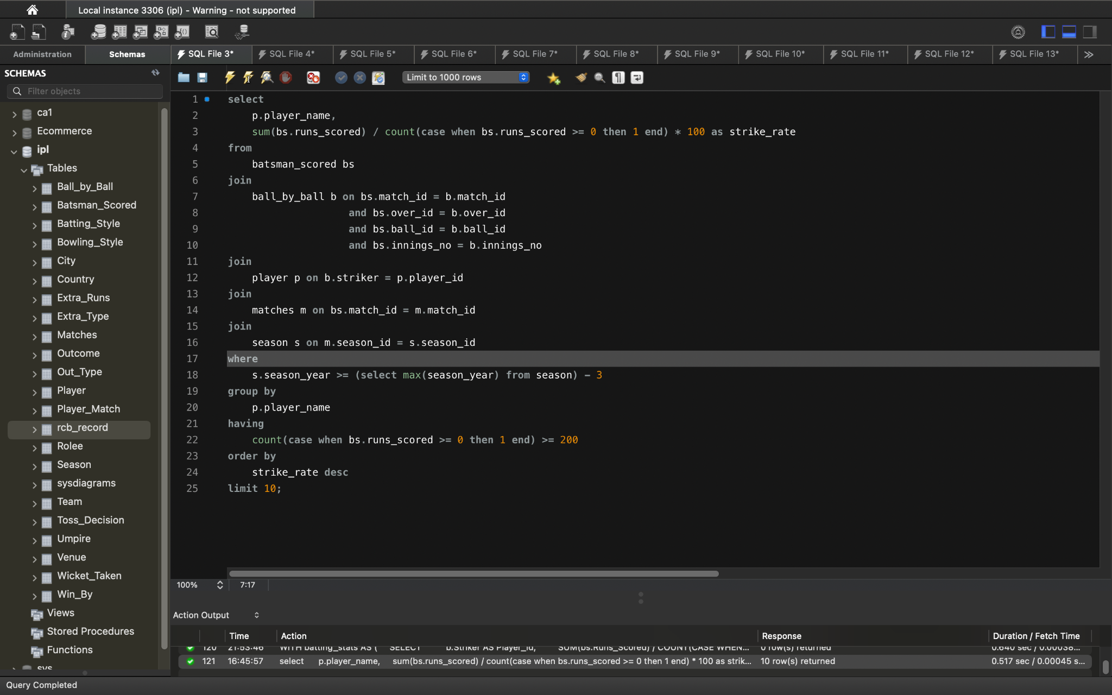
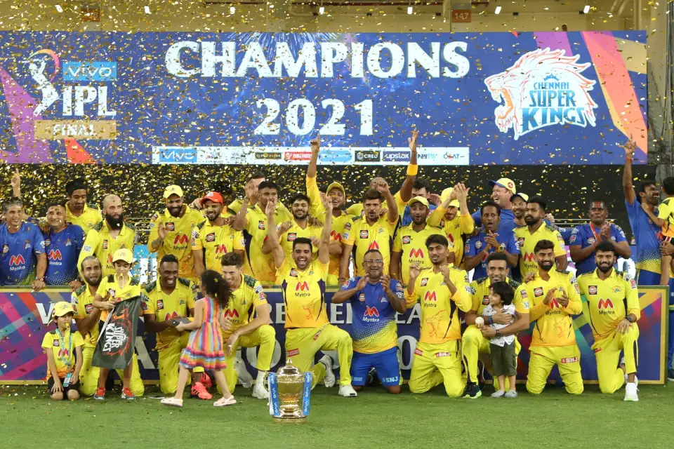
List of top 10 Players according strike rate last 4 seasons

Slide 8
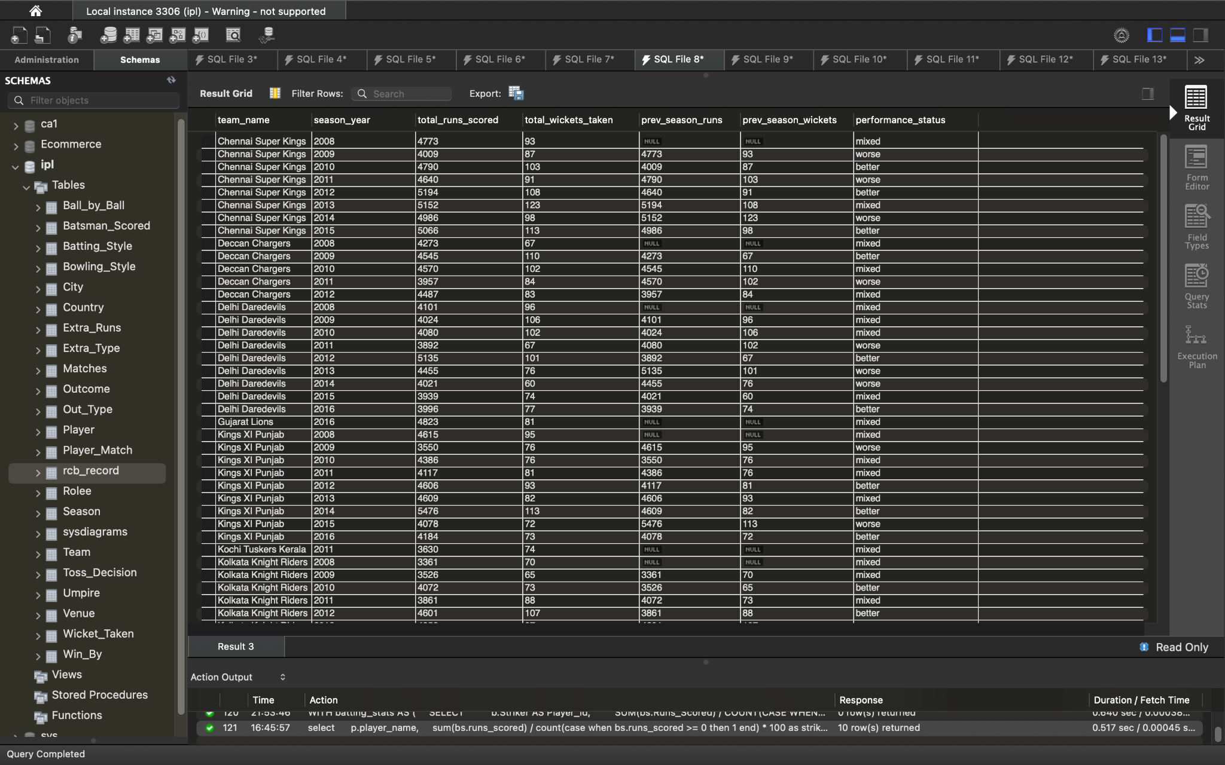
Status of the performance of the team is better than the previous year performance on the basis of number of runs scored by the team in the season and number of wickets taken ?
with seasonstats as (
select
t.team_name,
s.season_year,
sum(bs.runs_scored) as total_runs_scored,
count(distinct wt.match_id, wt.over_id, wt.ball_id, wt.innings_no) as total_wickets_taken
from
matches m
join
team t on m.team_1 = t.team_id or m.team_2 = t.team_id
join
season s on m.season_id = s.season_id
left join
ball_by_ball b on m.match_id = b.match_id
left join
batsman_scored bs on b.match_id = bs.match_id and b.over_id = bs.over_id and b.ball_id = bs.ball_id and b.innings_no = bs.innings_no
left join
wicket_taken wt on b.match_id = wt.match_id and b.over_id = wt.over_id and b.ball_id = wt.ball_id and b.innings_no = wt.innings_no and (b.team_bowling = t.team_id)
group by
t.team_name, s.season_year
),
teamcomparisons as (
select
curr.team_name,
curr.season_year,
curr.total_runs_scored,
curr.total_wickets_taken,
prev.total_runs_scored as prev_season_runs,
prev.total_wickets_taken as prev_season_wickets,
case
when curr.total_runs_scored > prev.total_runs_scored and curr.total_wickets_taken > prev.total_wickets_taken then 'better'
when curr.total_runs_scored < prev.total_runs_scored and curr.total_wickets_taken < prev.total_wickets_taken then 'worse'
else 'mixed'
end as performance_status
from
seasonstats curr
left join
seasonstats prev on curr.team_name = prev.team_name and curr.season_year = prev.season_year + 1
)
select *
from teamcomparisons
order by team_name, season_year;

Slide 9
RCB’s Past Season Performances & Potential Reason for not winning trophy
Overall Win-Loss Record
We'll calculate RCB's overall win percentage across all seasons and compare it to the average win percentage of all teams and the win percentage of teams that have won the IPL.
Season-wise Performance Trends
We'll track RCB's win percentage, runs scored per match, and wickets taken per match across different seasons to visualize any trends or patterns.
Performance in Crucial Matches
We'll analyze RCB's performance in playoff and final matches to see if they struggle under pressure.
Inconsistent performance
Underperformance in Crucial Matches
Batting & Bowling Weakness

Slide 10
KPIs for Team Strategy
Batting-focused KPIs
Dot Ball percentage
Run Rate in power play
Average Partnership
Bowling-focused KPIs
Dot Ball percentage
Strike Rate
Wickets in Powerplay
Fielding-focused KPIs
Catch Success Rate
Run outs

Slide 11

Suggestions
Before going the team for mega auction
Identify core players
Address Key Weaknesses
Leadership & Mentorship
Auction Strategy
Home Ground Advantage

Slide 12
Thank you

